Slide 1
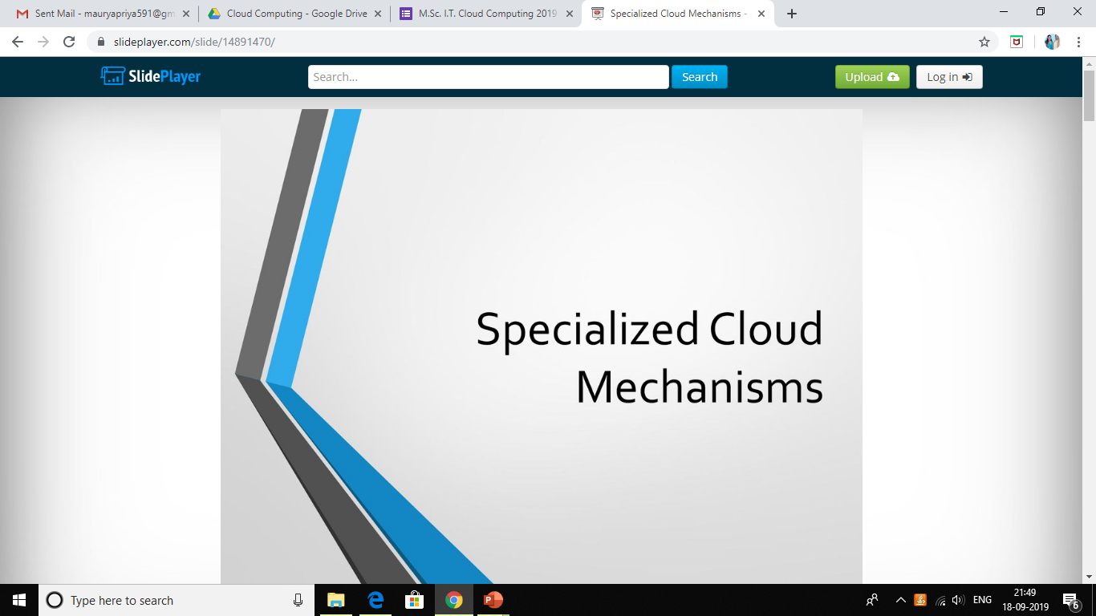
UNIT 3

Slide 2
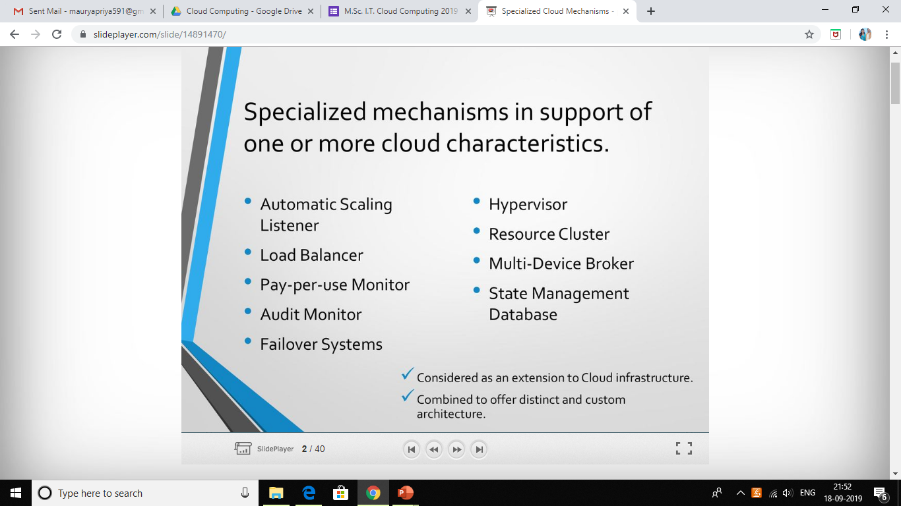

Slide 3
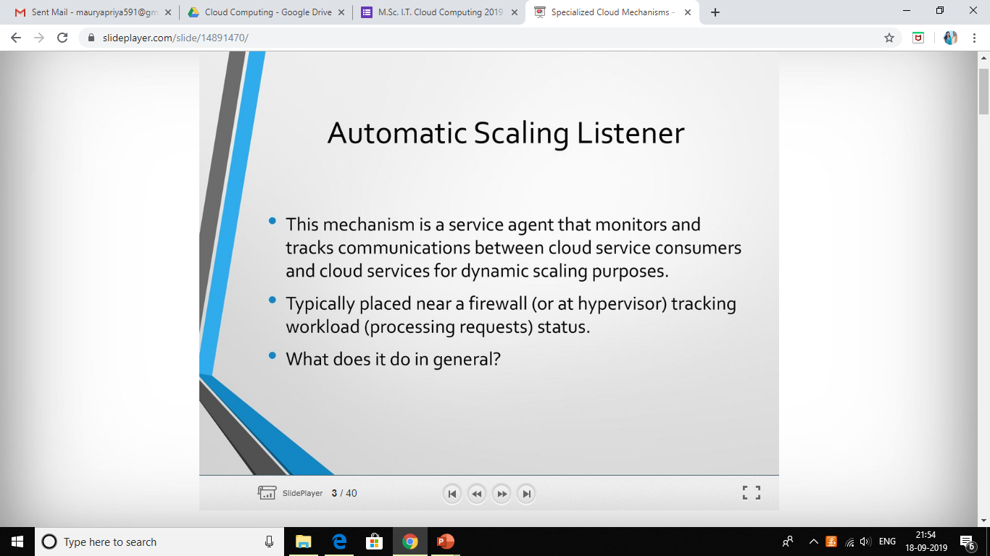

Slide 4
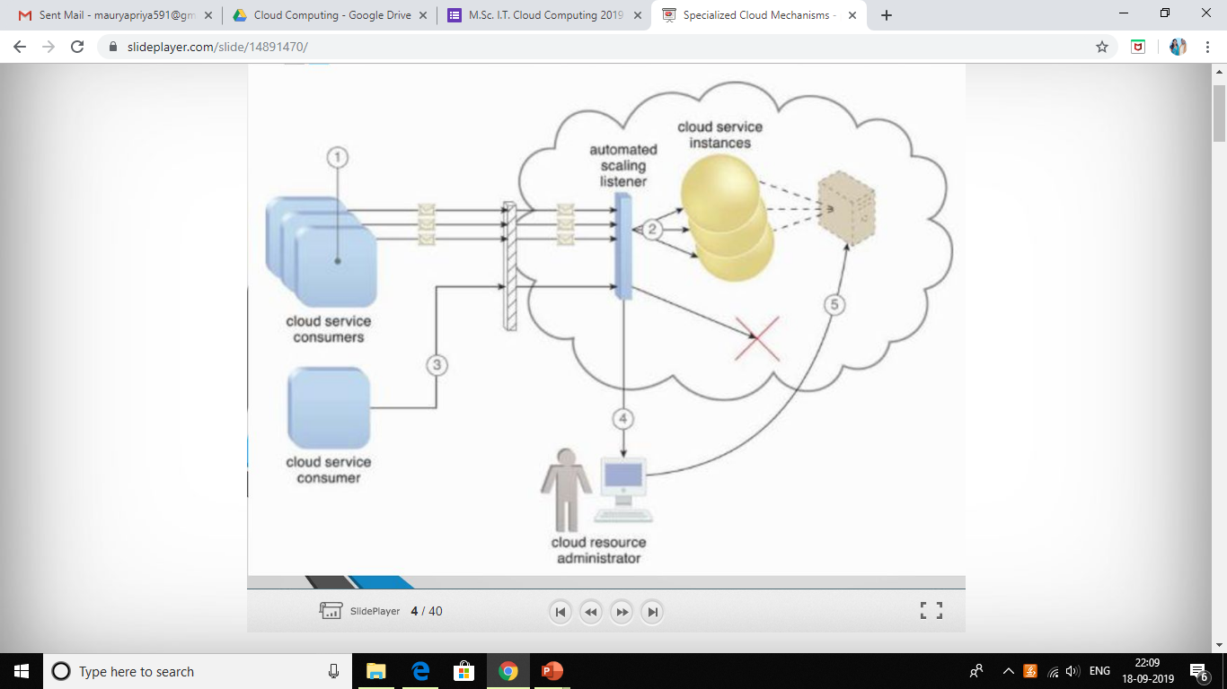

Slide 5
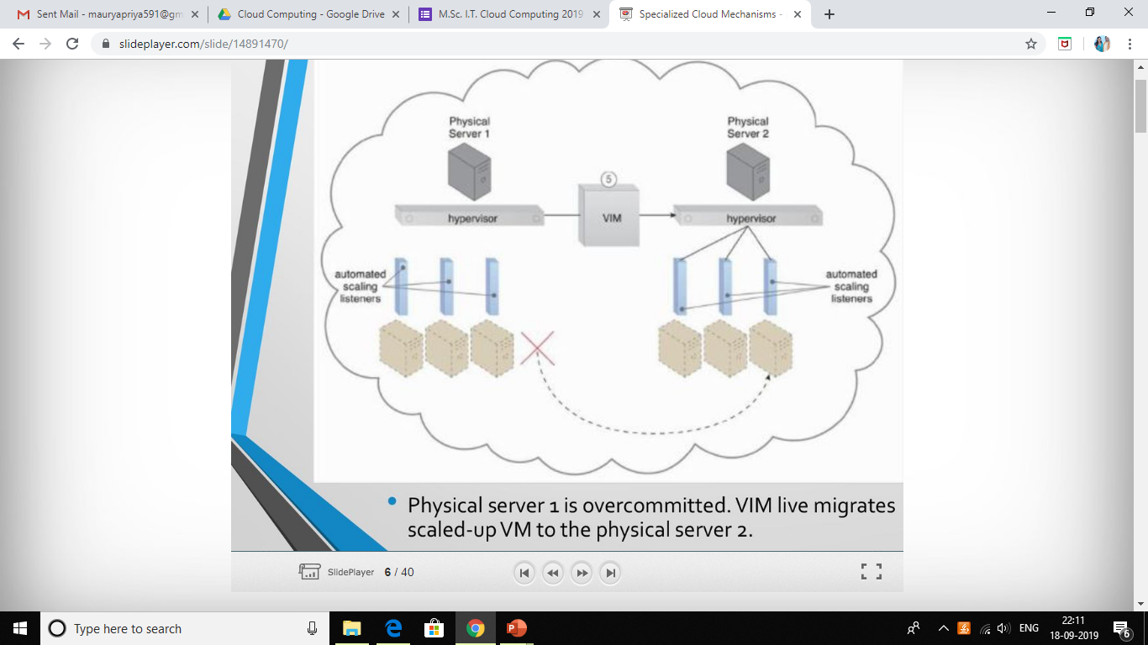

Slide 6
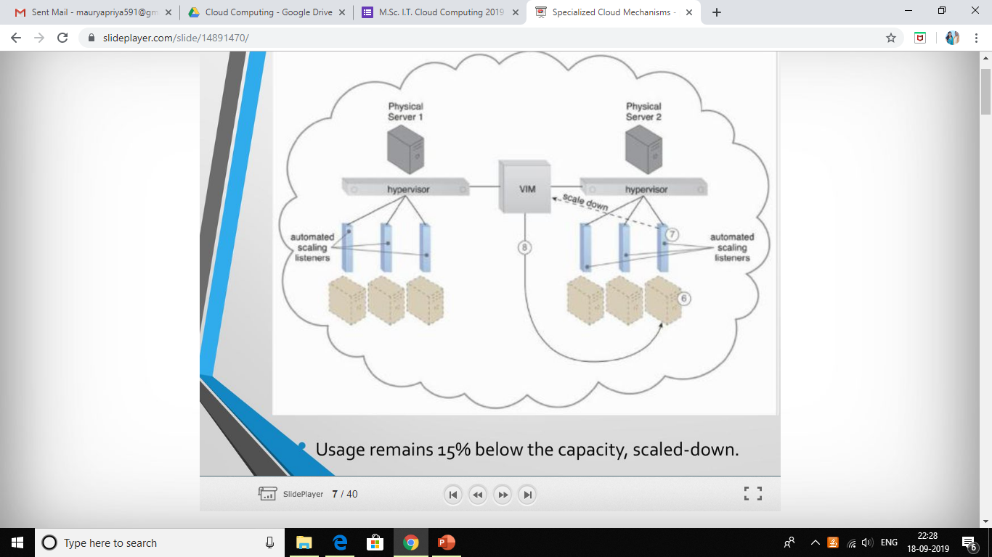

Slide 7
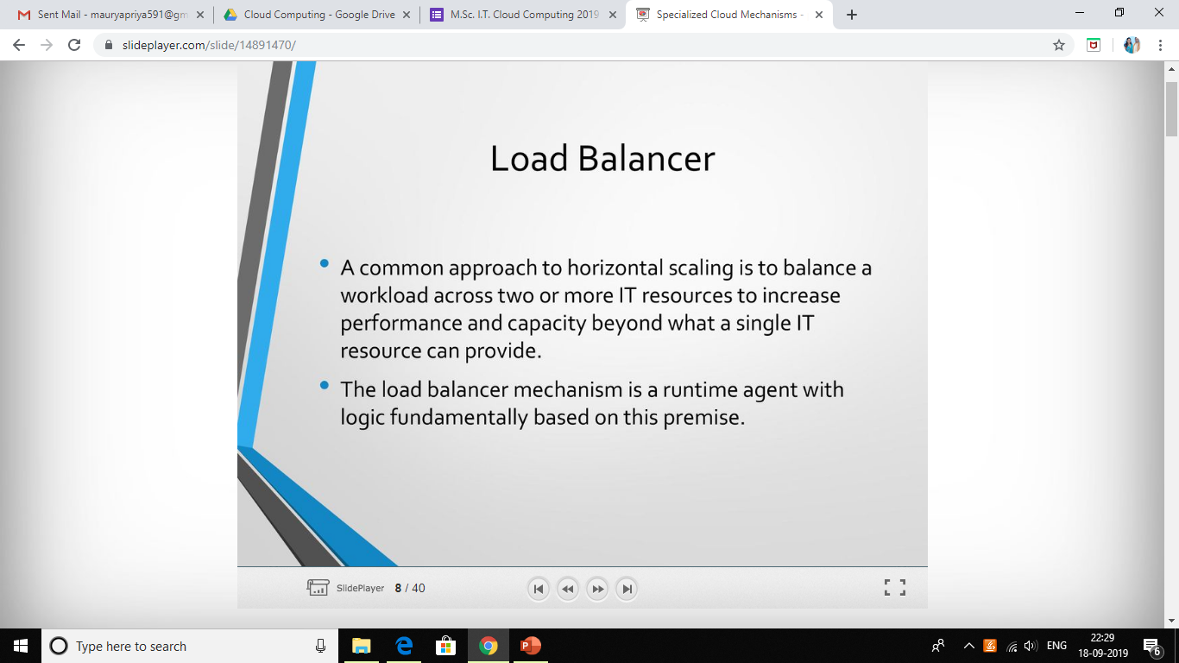

Slide 8
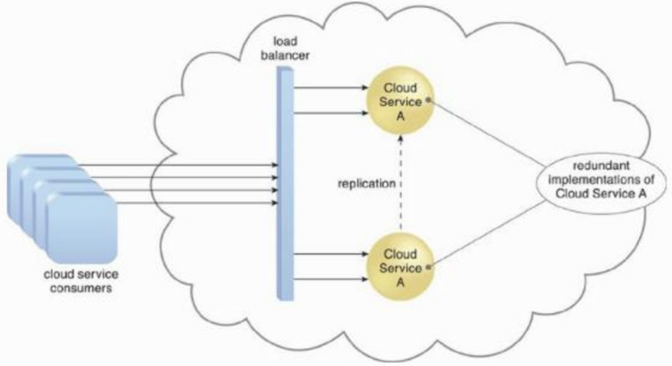

Slide 9
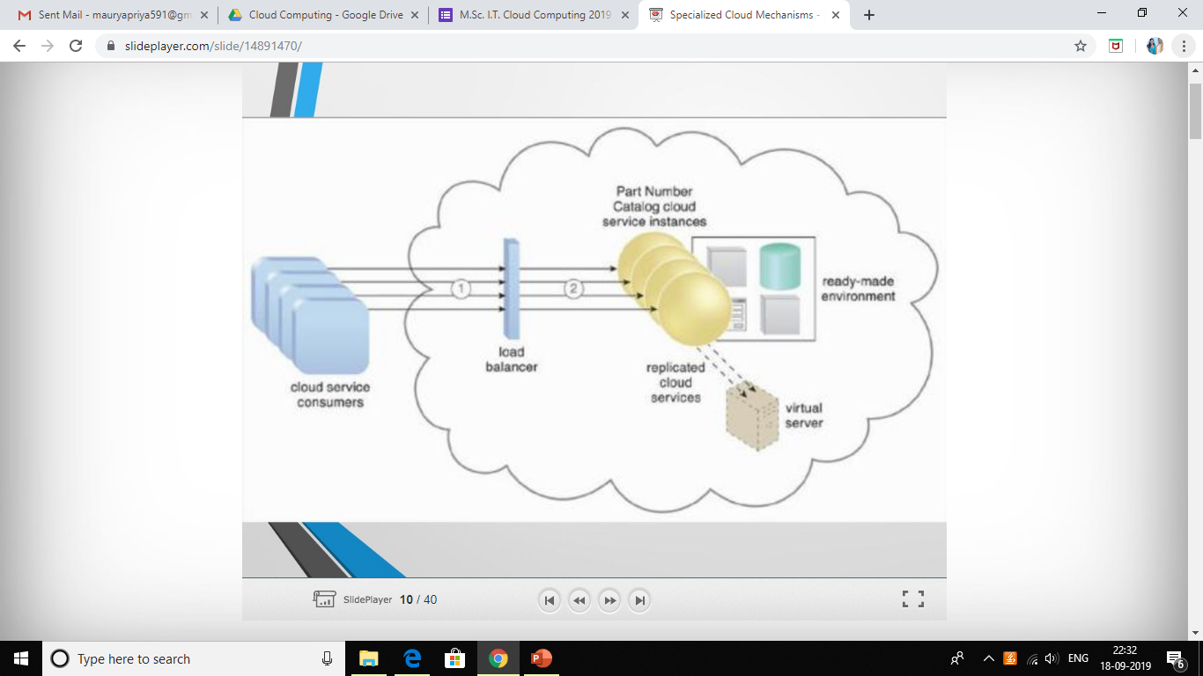

Slide 10
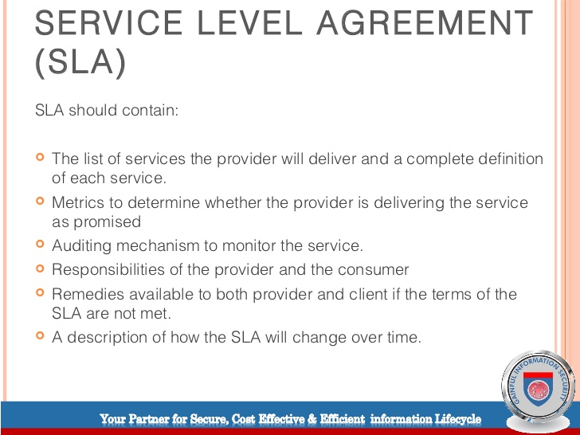

Slide 11
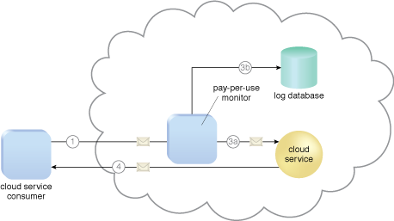
Pay-per-use monitor

Slide 12
CloudAudit is a specification for the presentation of information about how a cloud computing service provider addresses control frameworks.
The goal of CloudAudit is to provide cloud service providers with a way to make their performance and security data readily available for potential customers.

Slide 13
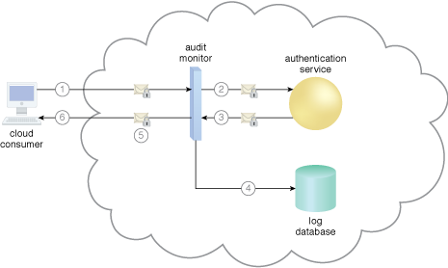

Slide 14
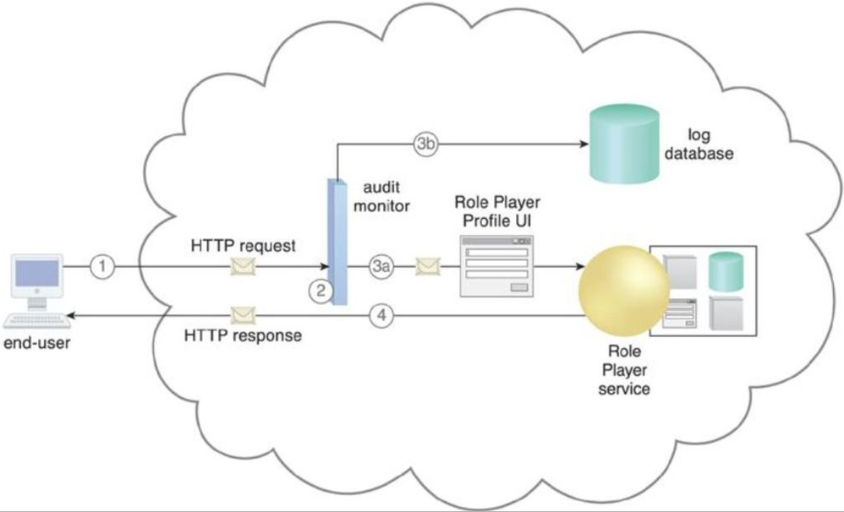

Slide 15
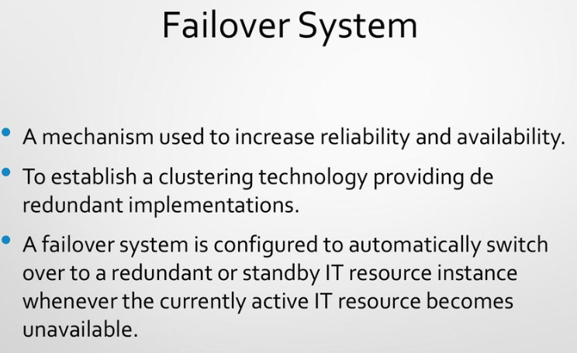

Slide 16
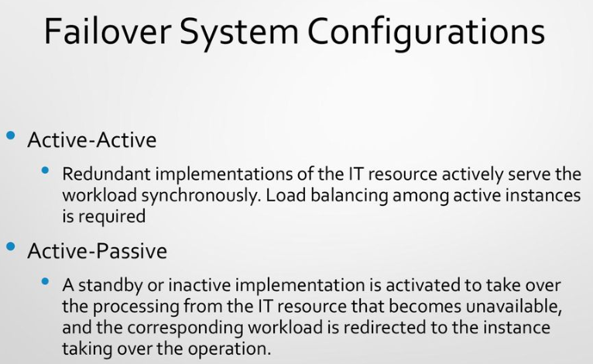

Slide 17
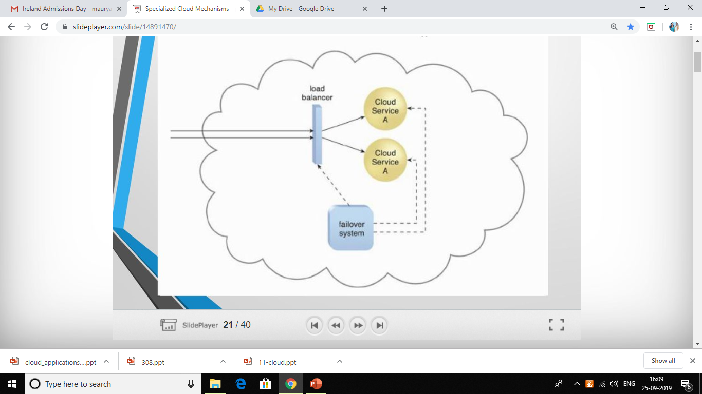

Slide 18
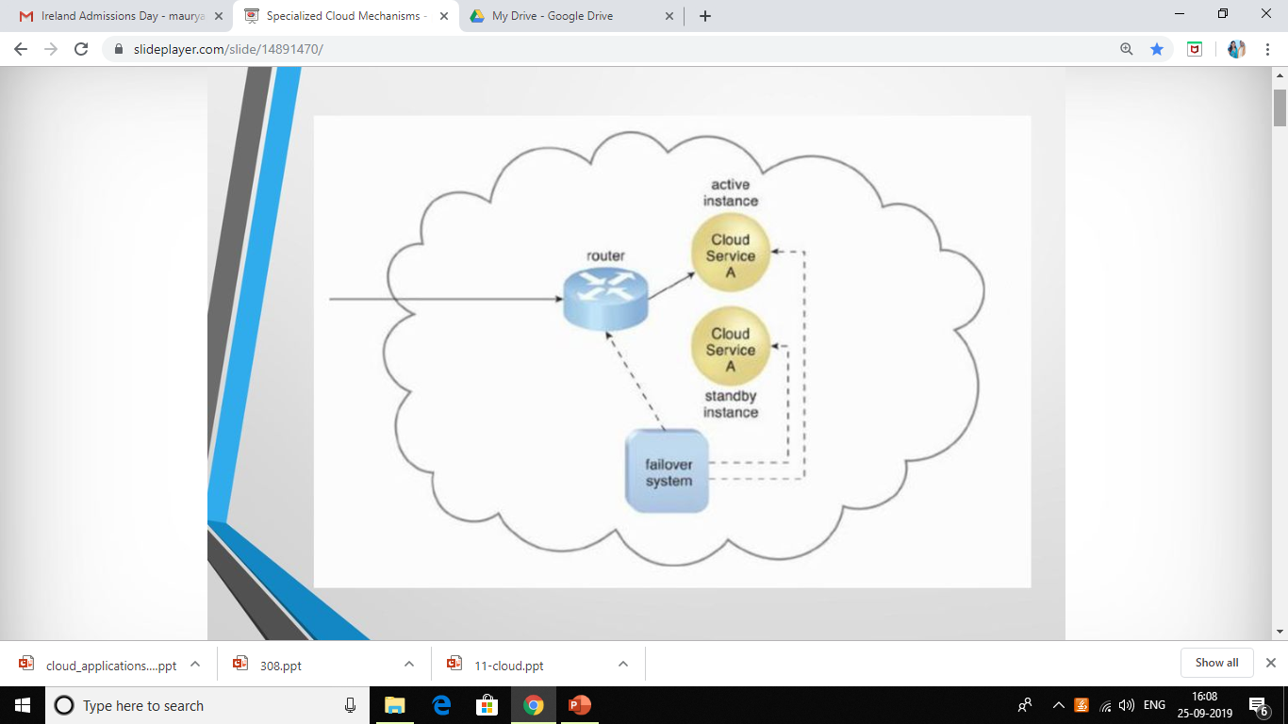

Slide 19
Hypervisors are virtual machine monitor(VMM) that enables numerous virtual operating systems to simultaneously run on a computer system. ... Each virtual machine is independent and do not interfere with each another although they run on the same host machine. They are no way connected to one another.

Slide 20
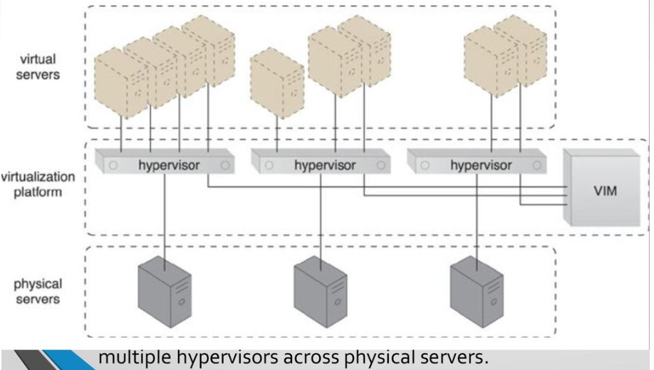

Slide 21
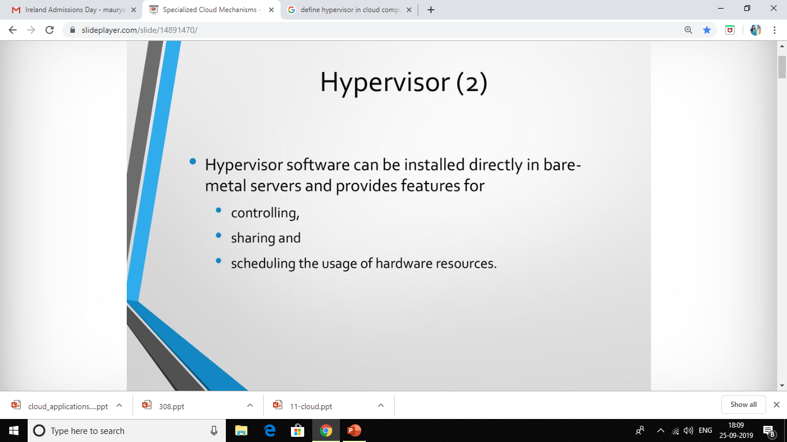

Slide 22
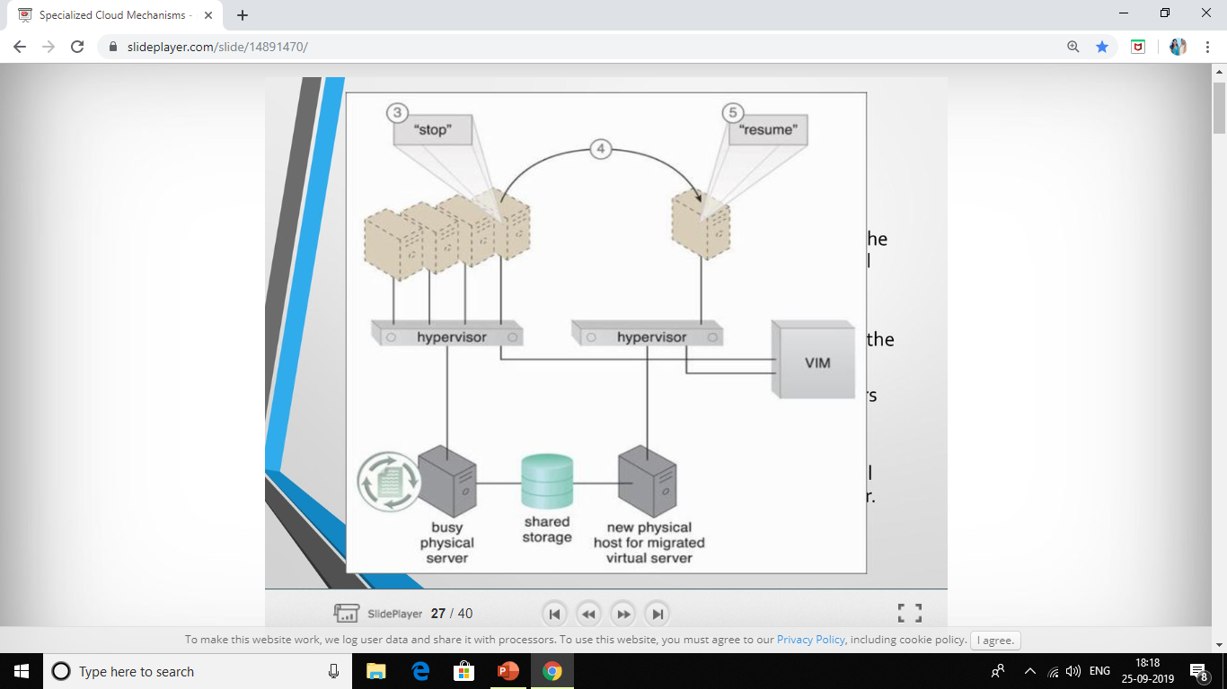

Slide 23
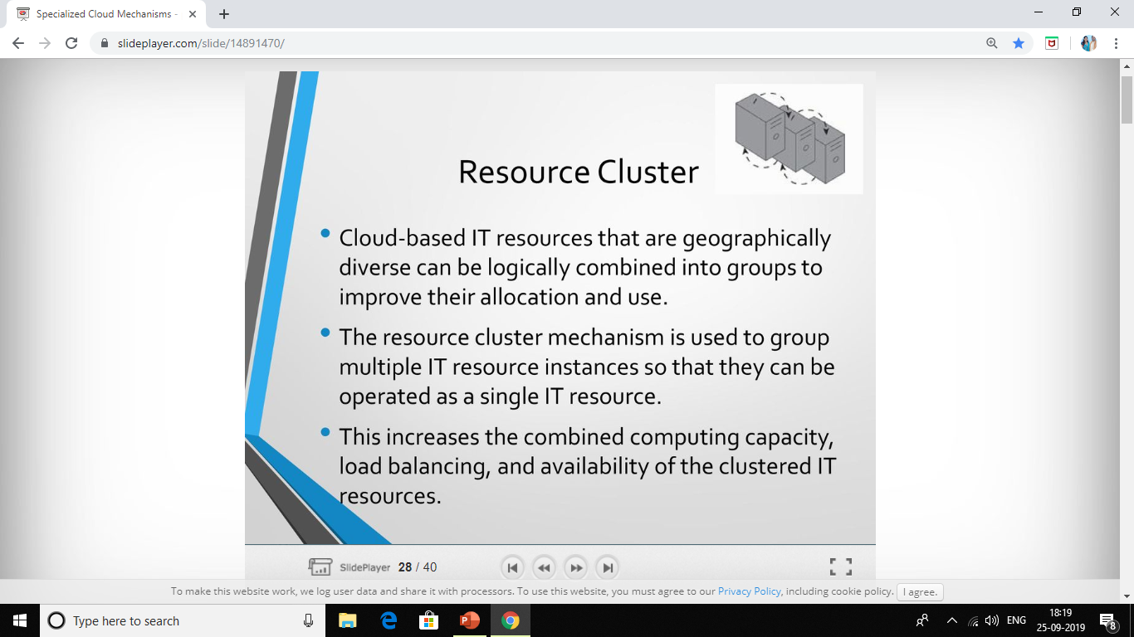

Slide 24
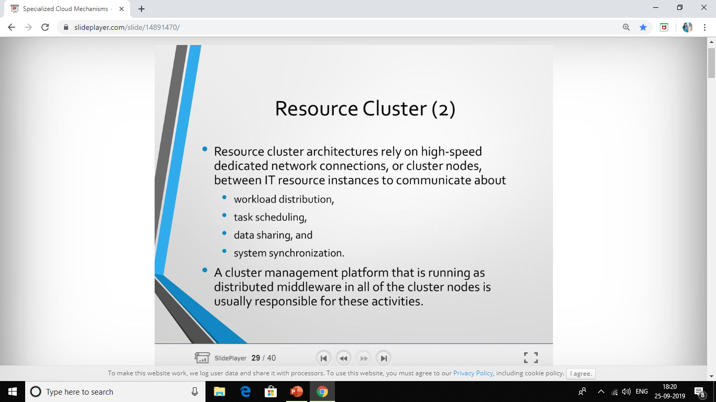

Slide 25
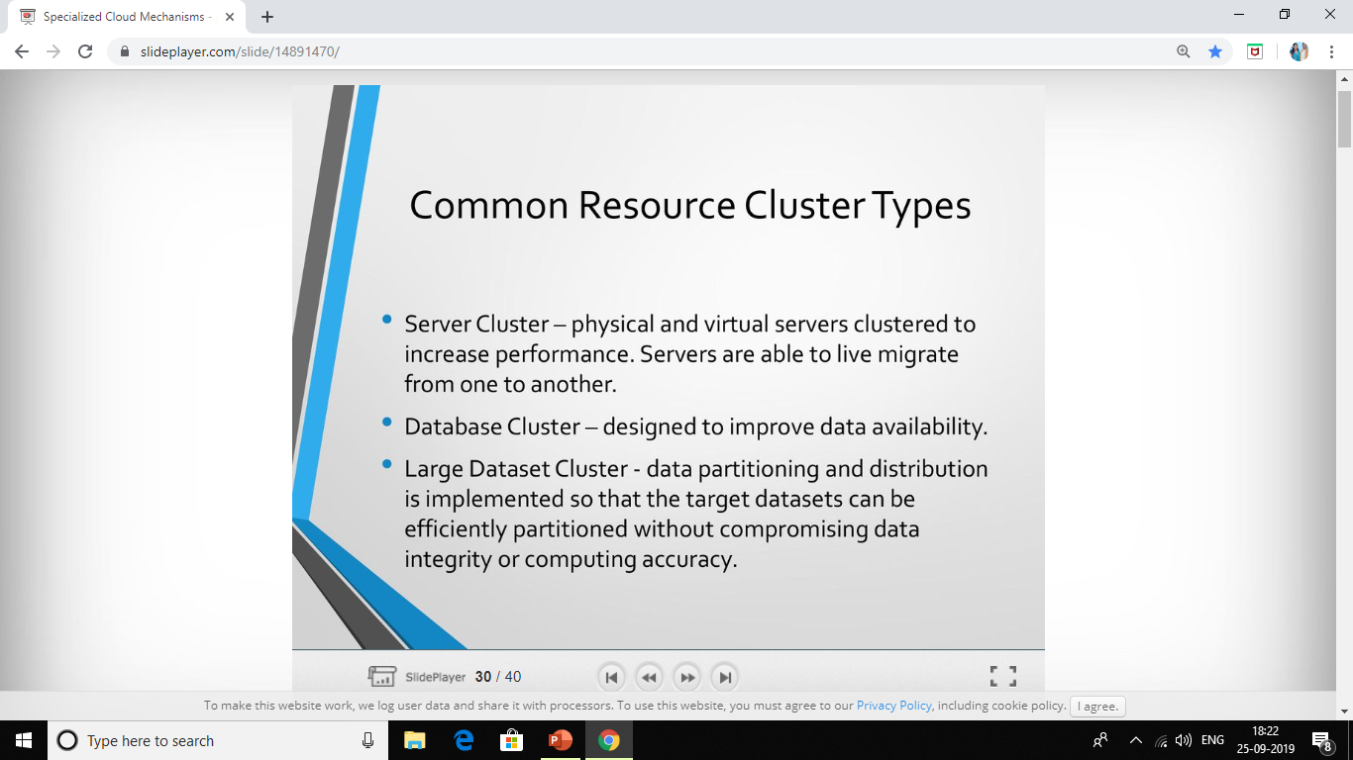

Slide 26
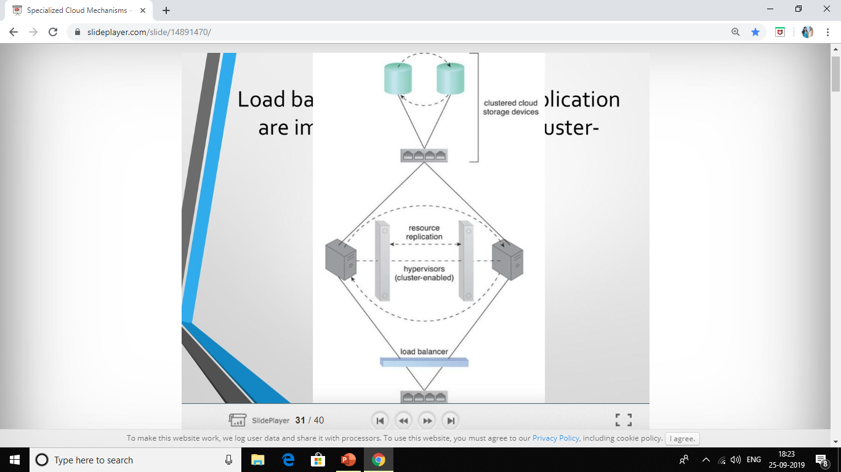

Slide 27
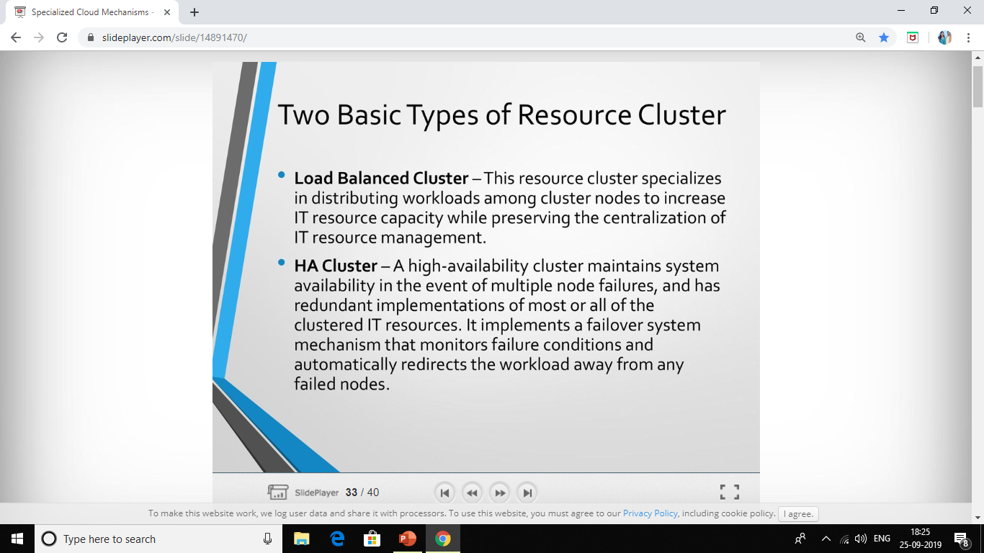

Slide 28
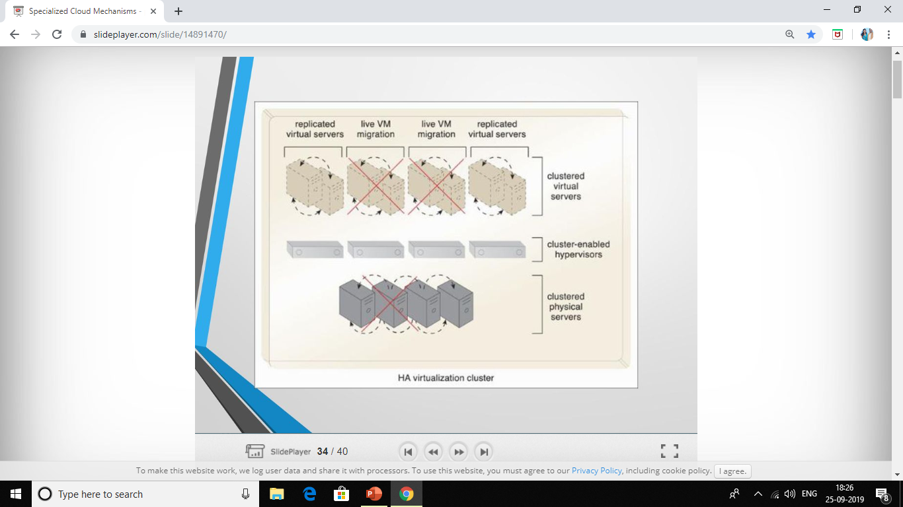

Slide 29
MULTIDEVICE BROKER

Slide 30
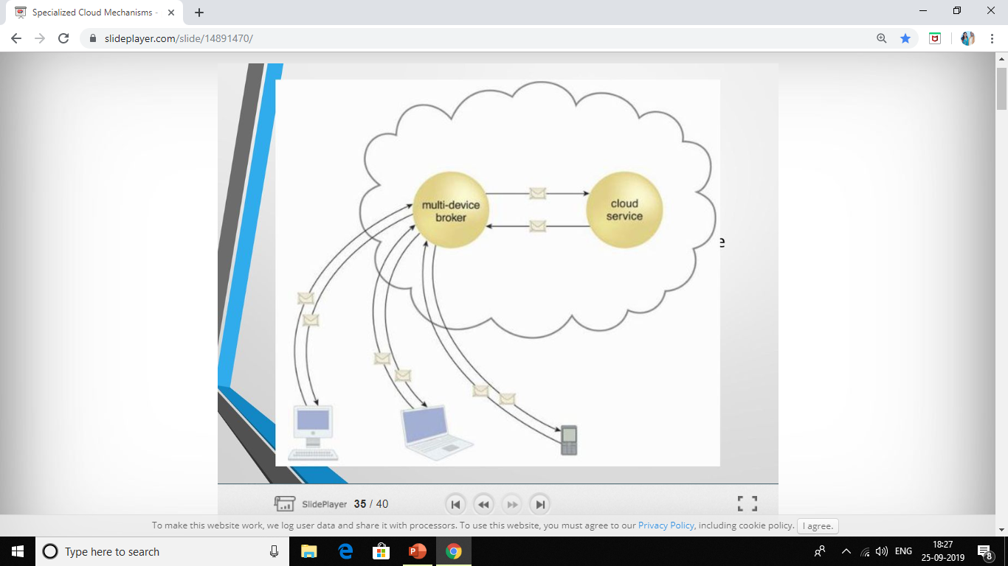

Slide 31
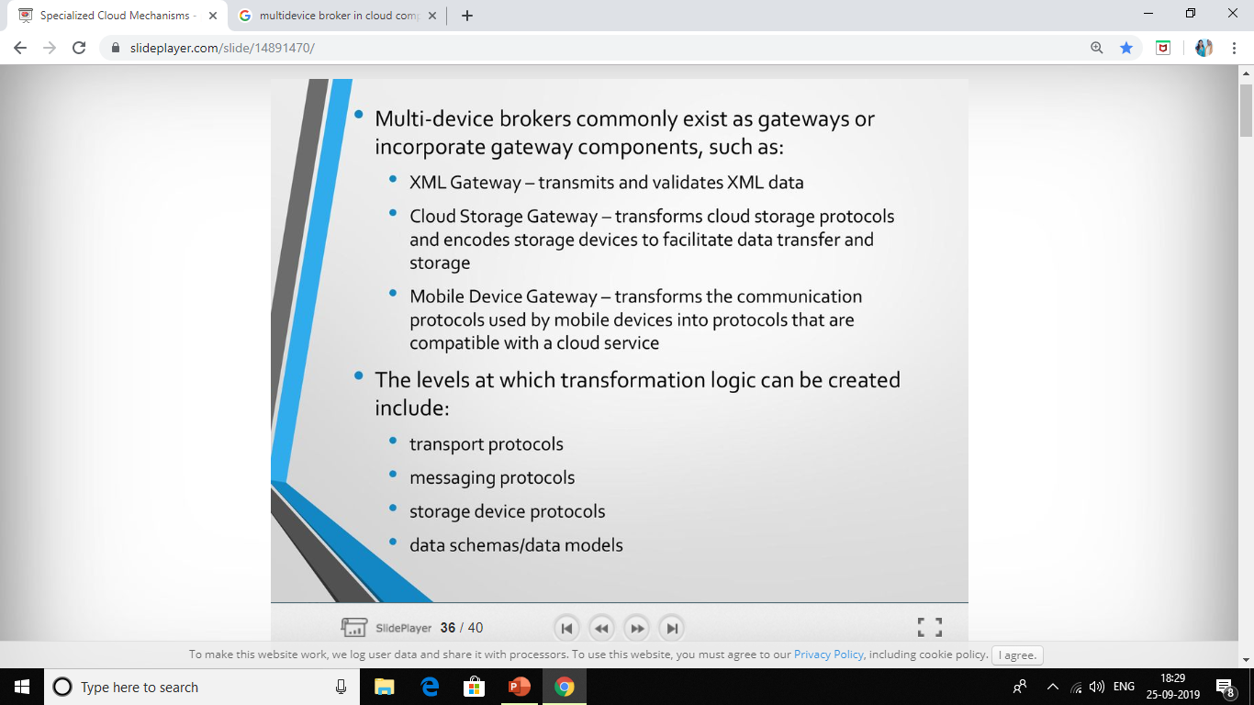

Slide 32
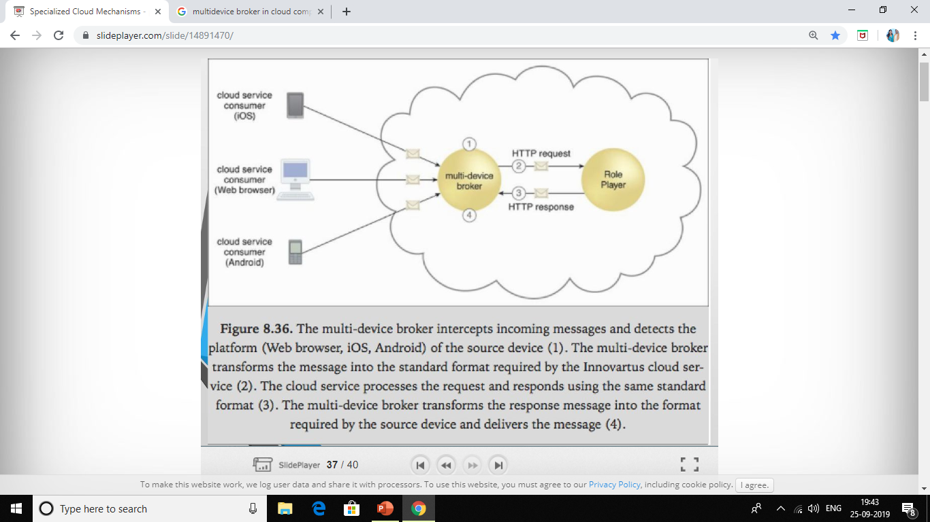

Slide 33
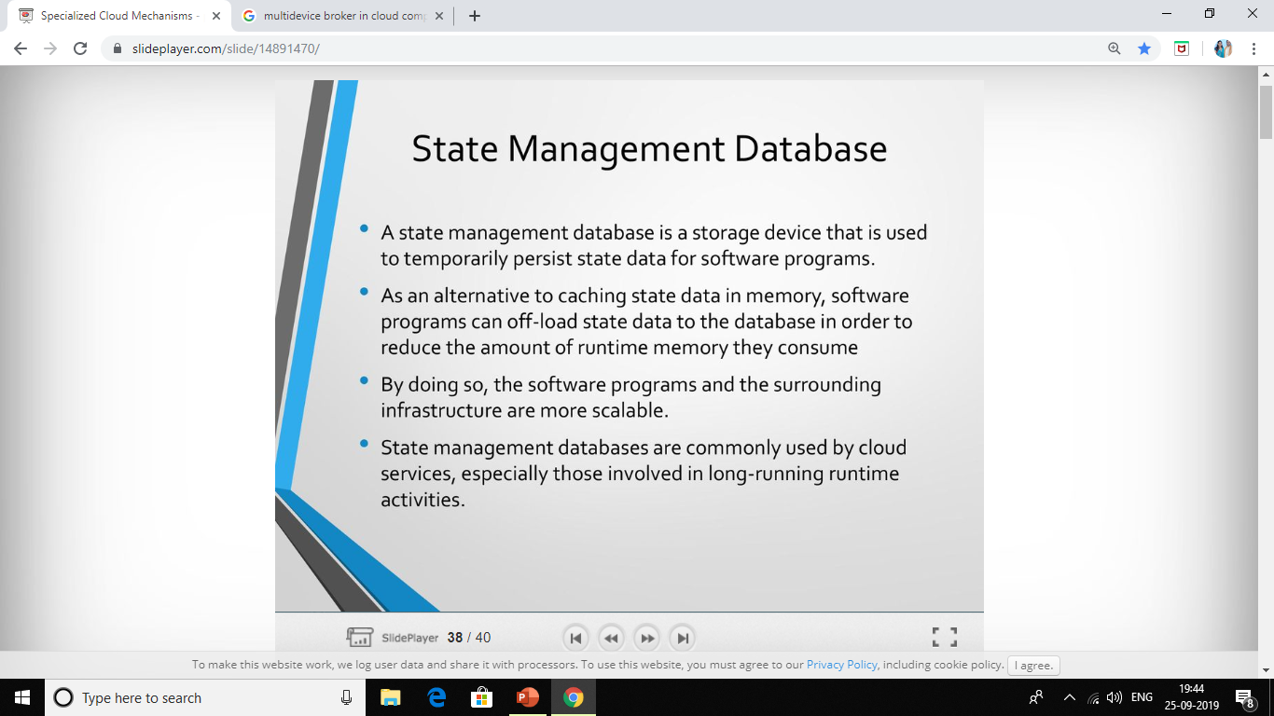

Slide 34
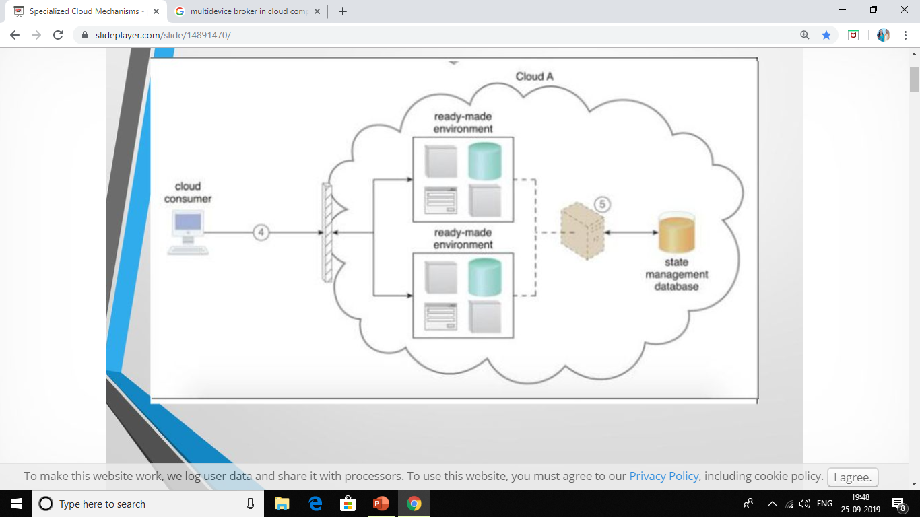

Slide 35
UNIT 3
CHAPTER 2 CLOUD MANAGEMENT MECHANISMS

Slide 36
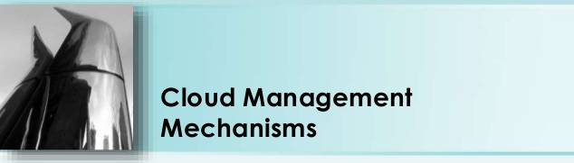

Slide 37
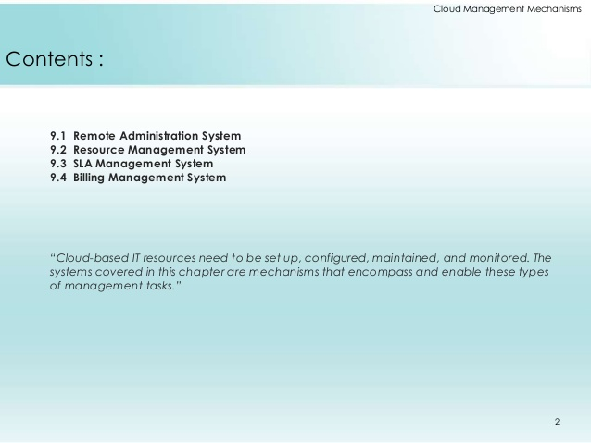
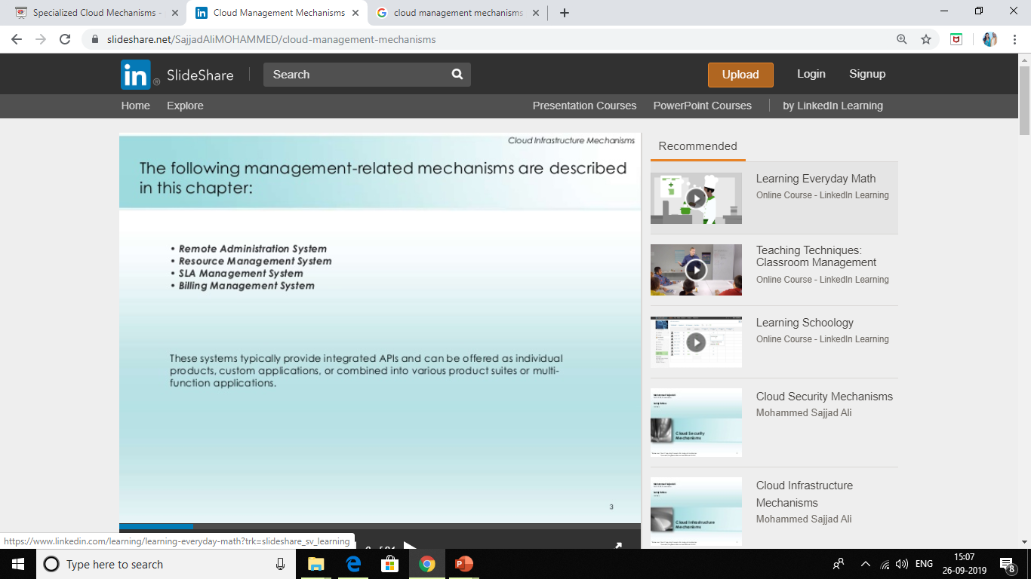

Slide 38
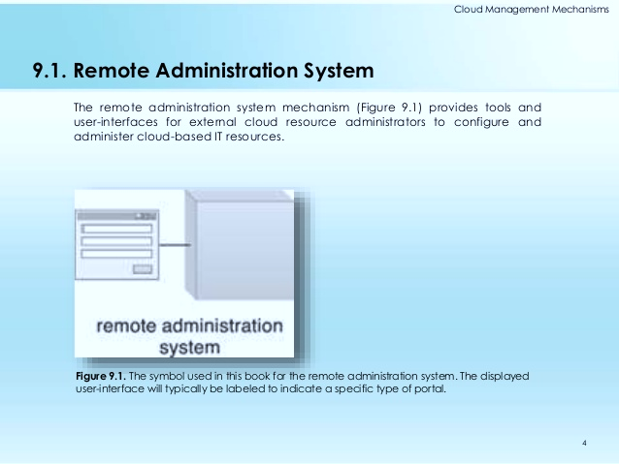

Slide 39
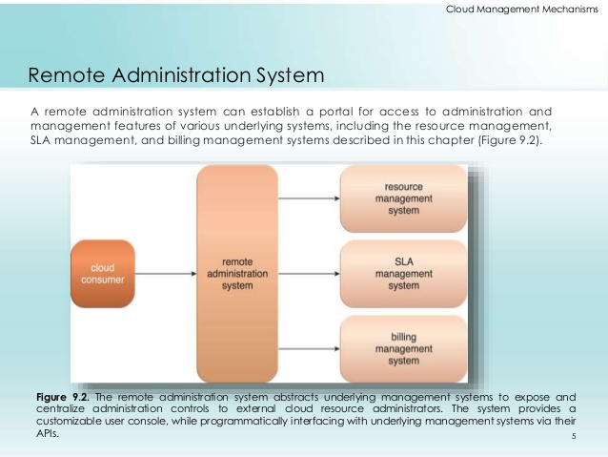

Slide 40
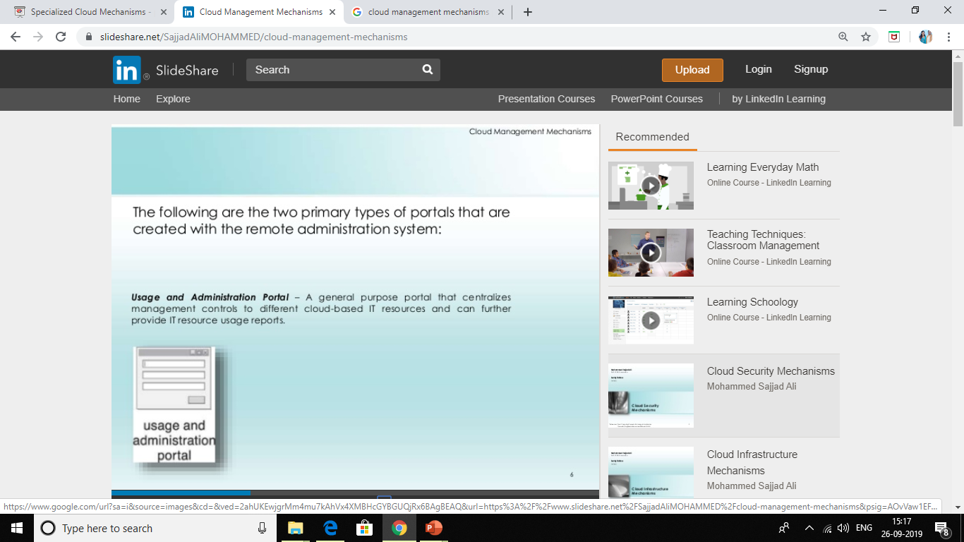

Slide 41
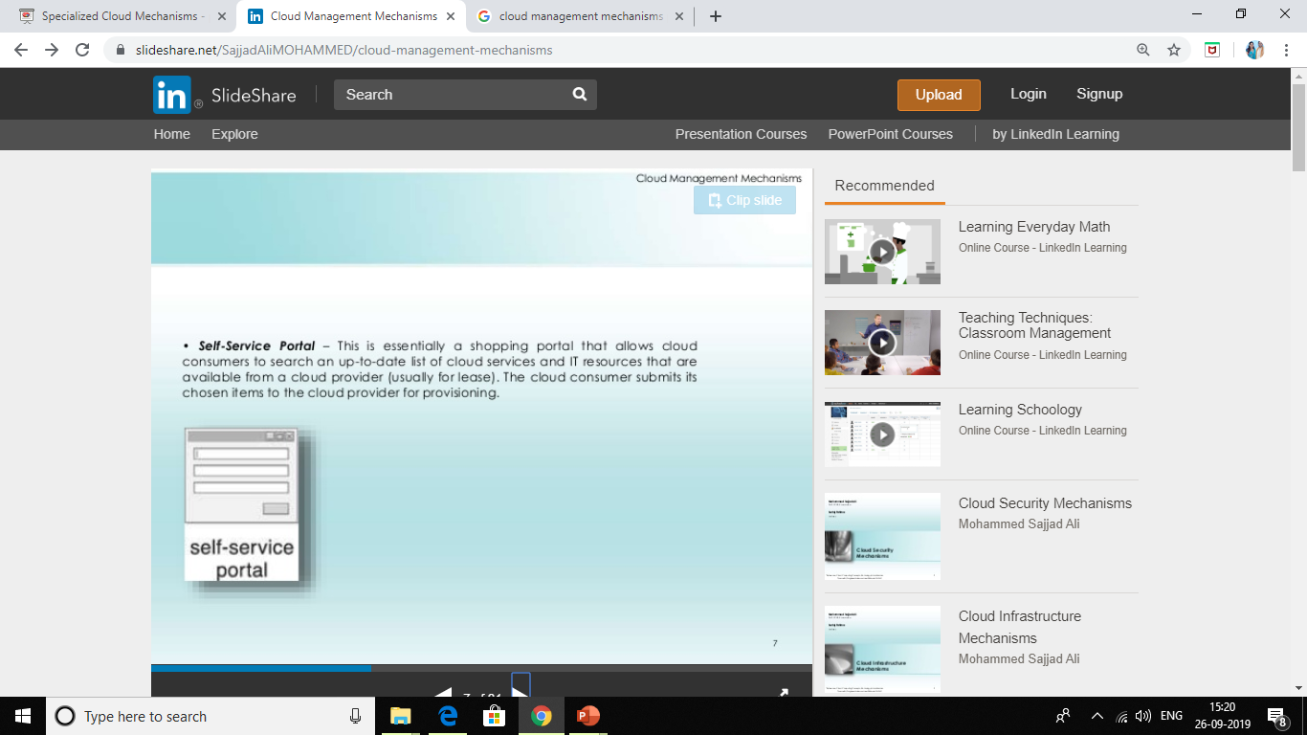

Slide 42
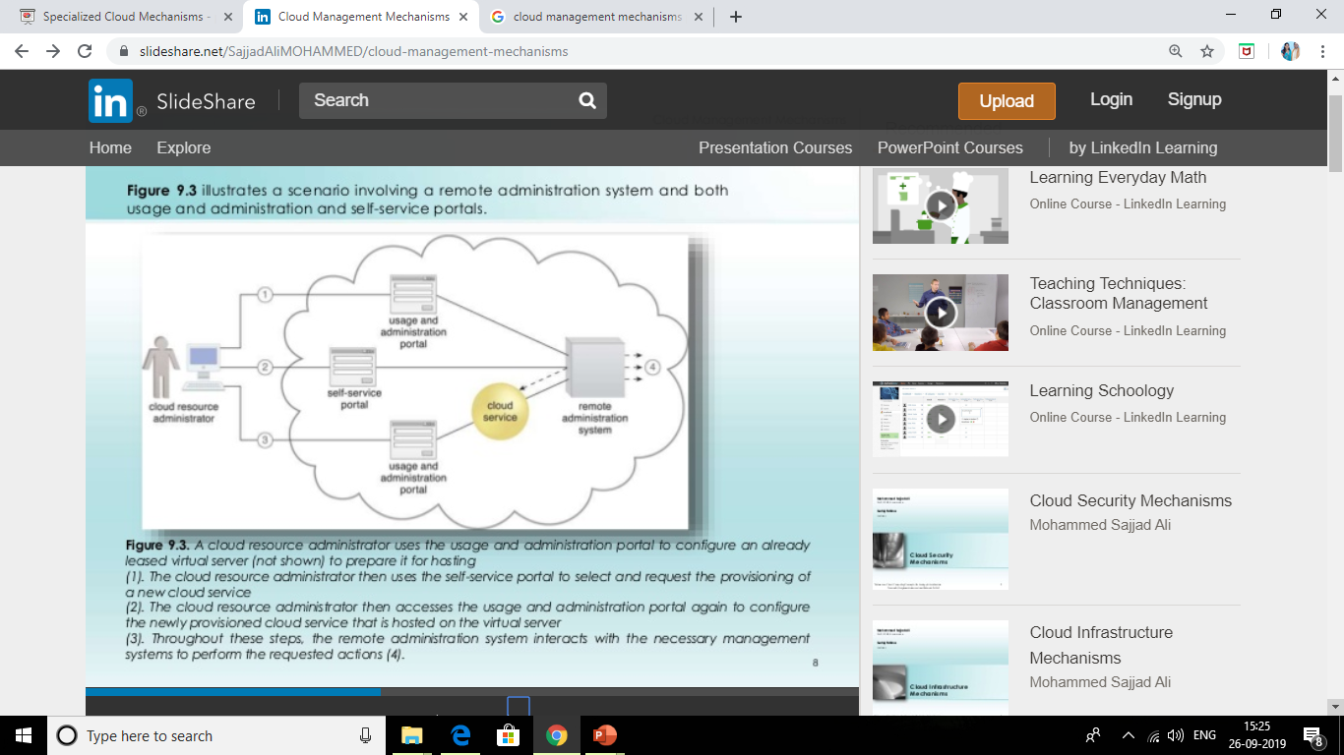

Slide 43
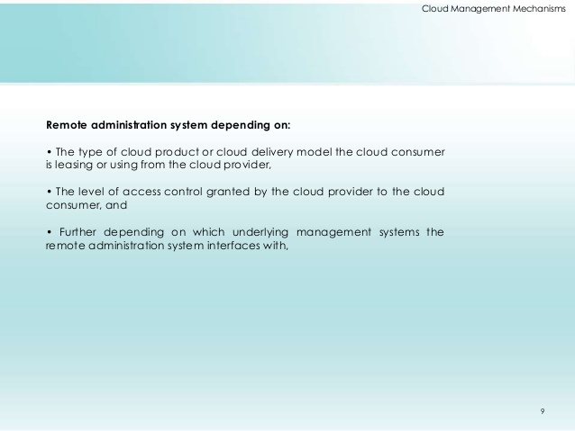

Slide 44
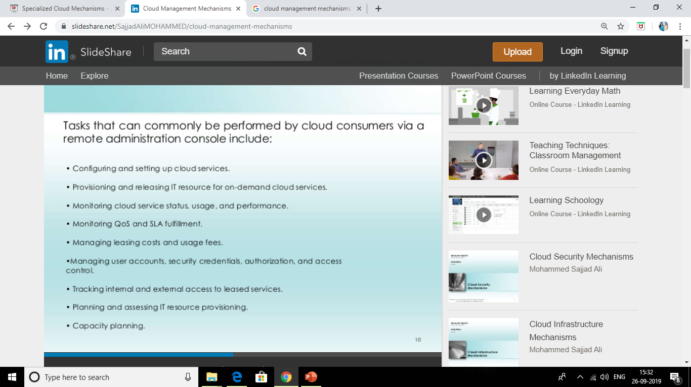

Slide 45
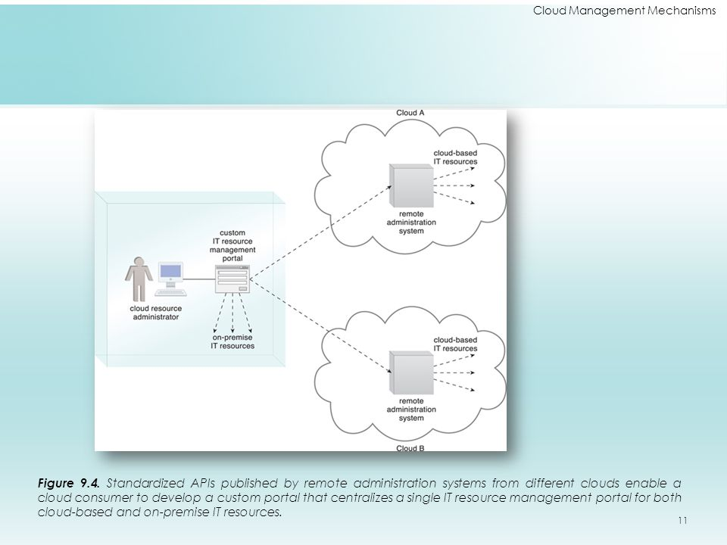

Slide 46
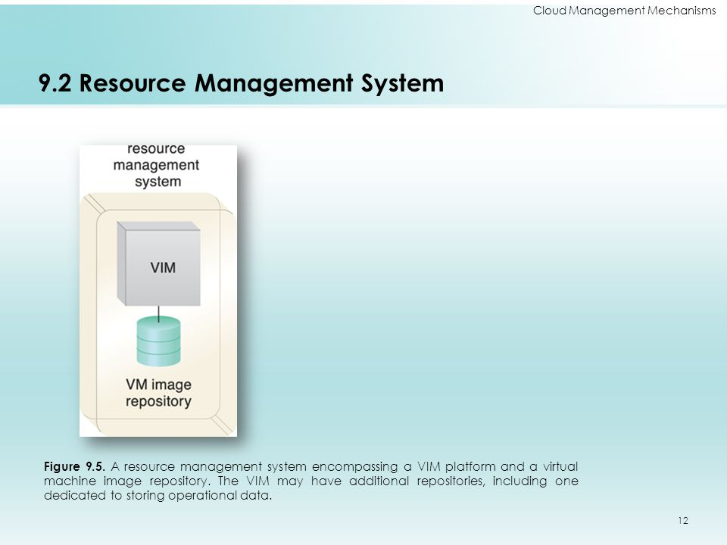

Slide 47
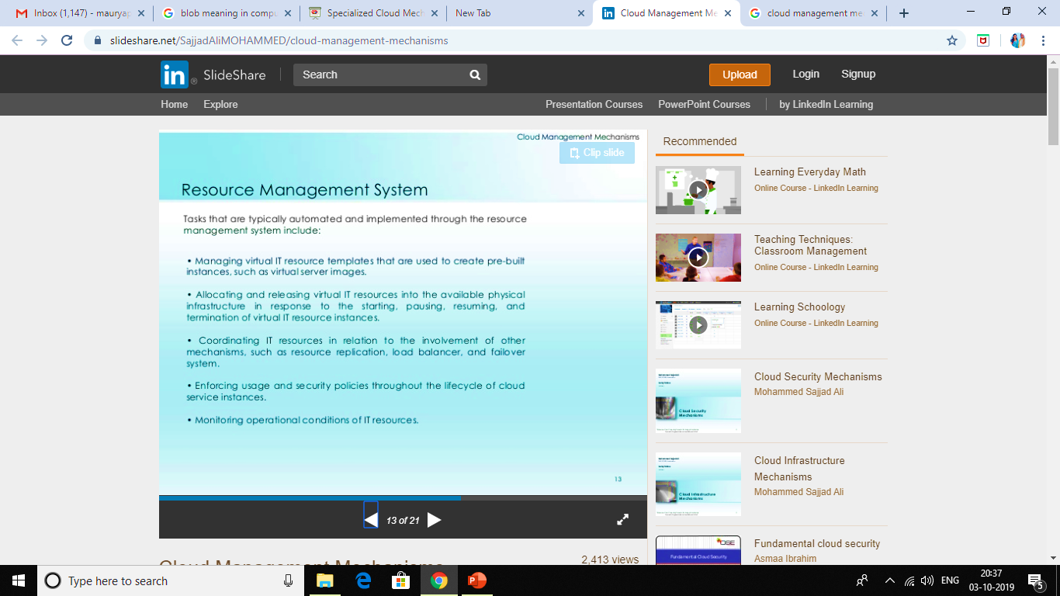

Slide 48
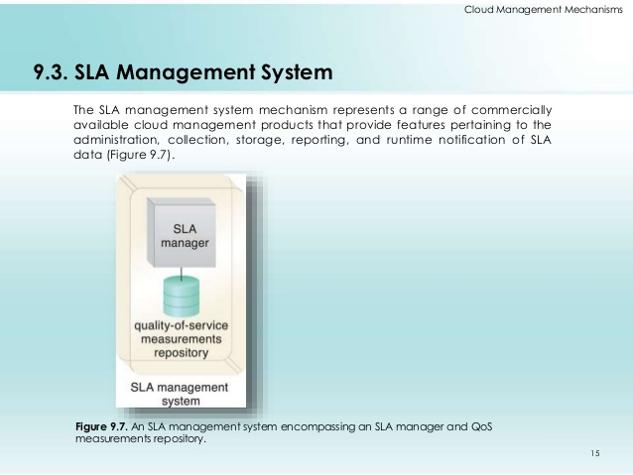

Slide 49
Sla management systems
An SLA management system deployment will generally include a repository used to store and retrieve collected SLA data based on pre-defined metrics and reporting parameters.
It will further rely on one or more SLA monitor mechanisms to collect the SLA data that can then be made available in near –real time to usage and administration portaits to provide on-going feedback regarding active cloud services.

Slide 50
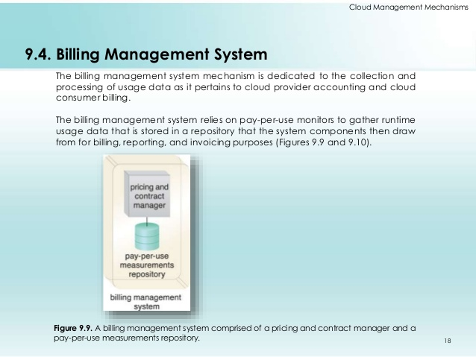

Slide 51
As the fig. of cloud service consumer exchanges messages with a cloud service . 1. a pay-per-use monitor keeps track of the usage and collects data relevant to billing. 2.(A)which is forwarded to a repository that is part of the billing management system. 2(B)the system periodically calculates the consolidated cloud service usage fees and generates an invoice for the cloud consumer. (3) the invoice may be provided to the cloud consumer through the usage and administration portal(4).

Slide 52
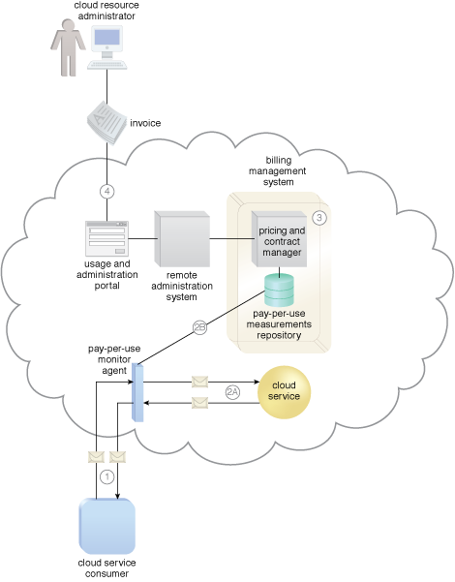

Slide 53
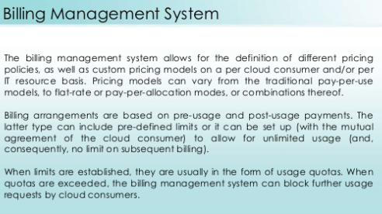

Slide 54


Slide 55
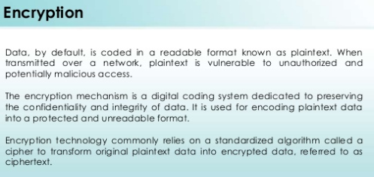

Slide 56
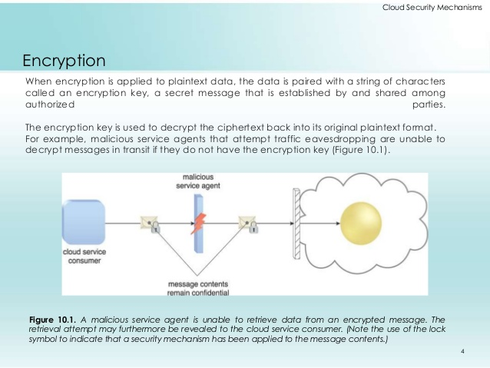

Slide 57


Slide 58


Slide 59


Slide 60


Slide 61


Slide 62


Slide 63


Slide 64


Slide 65


Slide 66


Slide 67


Slide 68


Slide 69



Slide 70


Slide 71


Slide 72


Slide 73


